Slide 1
Enter the Matrix: Machine Learning Workflows
For Competitors
Notes:
The title of the speech
I’ll say my name in the end. Remember me.
https://goo.gl/forms/zUsMQVHsEEnWXoCG2

Slide 2
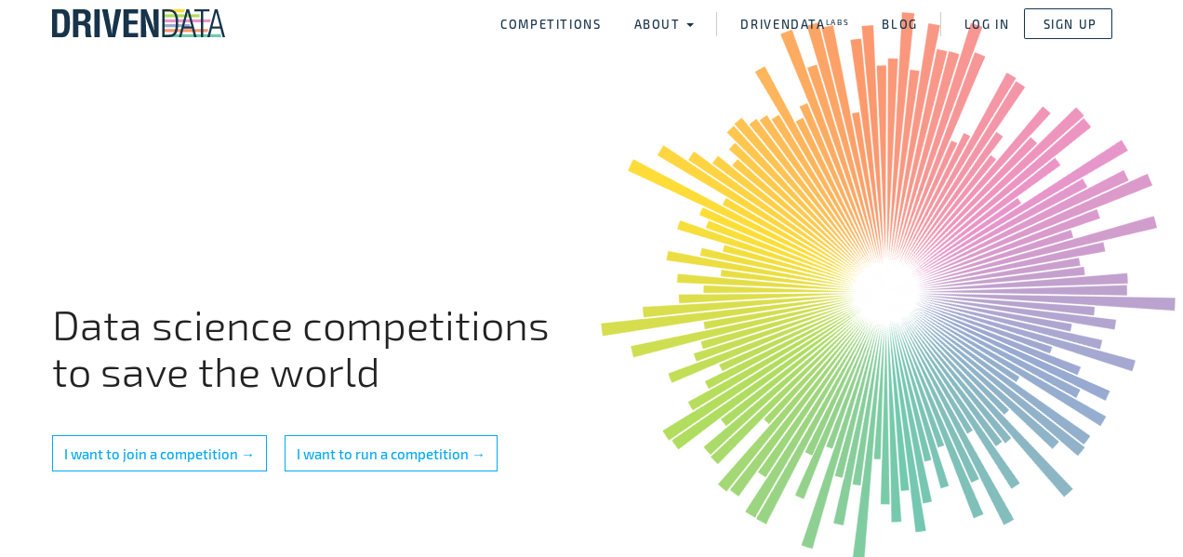
Visit drivendata.org
Notes:
Talk about the competition close to us the Pump it up: Data Mining the water table challenge in Tanzania
Can you predict which water pumps are faulty? can you predict which pumps are functional, which need some repairs, and which don't work at all?
Multi-class classification problem. Try it you can do it https://www.drivendata.org/competitions/7/pump-it-up-data-mining-the-water-table/page/25/

Slide 3
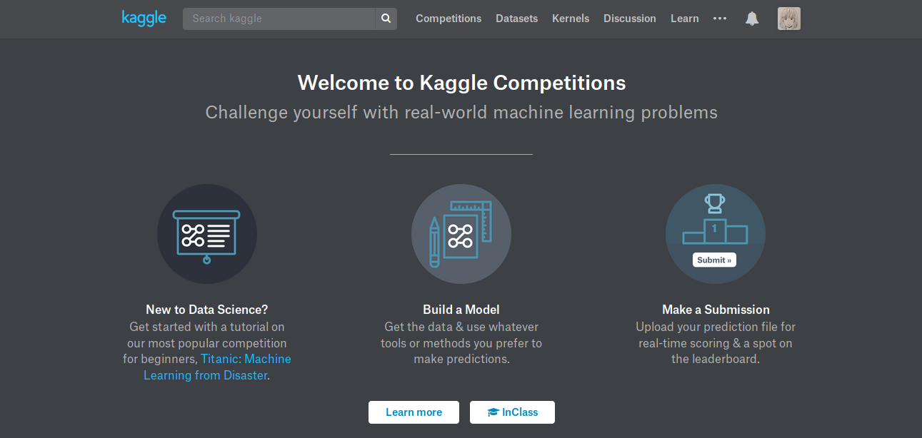
Check out https://www.kaggle.com/competitions

Slide 4
You got nothing on me Agent Smith!
Input variables
classifier
Gif credit: http://knowyourmeme.com/photos/727306-the-matrix
Notes:
The goal of this speech to make you dangerous

Slide 5
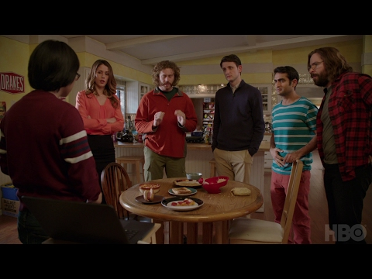
Applications of machine learning
Image classification
HAZAR!
Notes:
This is a classification problem; an Image classification problem. Classic problem! This is supervised learning(learn from input/output pairs predictors/target pairs). Said differently you have labeled data and the machine learning system is able classify(categorise) unlabeled data to make a decision. Do you watch this show?
Others include:
Spam email detection.
Churn Prediction.
Drug response

Slide 6
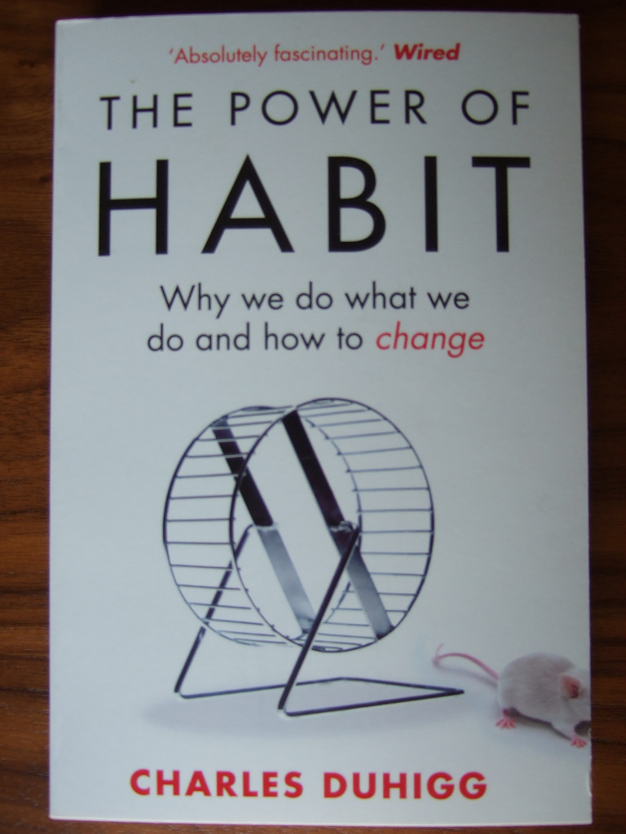
Applications of machine learning
Segmenting customers into groups based on similar preferences.
Notes:
Target was able to determine whether someone is pregnant based on their shopping activity. They send a coupon to a minor who their ‘machine’ thought was expectant and the dad was so furious. Yet they got it right later on. This is the power of unsupervised learning finding patterns in data. This was a rumor could you find out if it was true.

Slide 7
Main points:
Review of machine learning: Definitions, other important terms algorithm, model and a hyperparameter
Machine Learning analogy diagrams
The Universal Machine Learning Workflow
An example supervised learning problem R and Python together
Review
Use what you’ve learned in the ‘Don’t overfit competition on Kaggle.’
Notes:
Review of machine learning: Definitions, algorithm, model, and a hyperparameter
Machine learning analogy diagrams
The Universal Machine learning workflow
An example of supervised learning in R and Python
Review
Use what you've learned in the 'Don't overfit competition on Kaggle.'
[Where u've reached]

Slide 8
Definitions
A machine learning workflow?
Stepwise approach to handle a problem you’ll face in this case ML problem.
It’s also called the Universal Machine Learning Workflow.
Notes:
Thesis statement

Slide 9
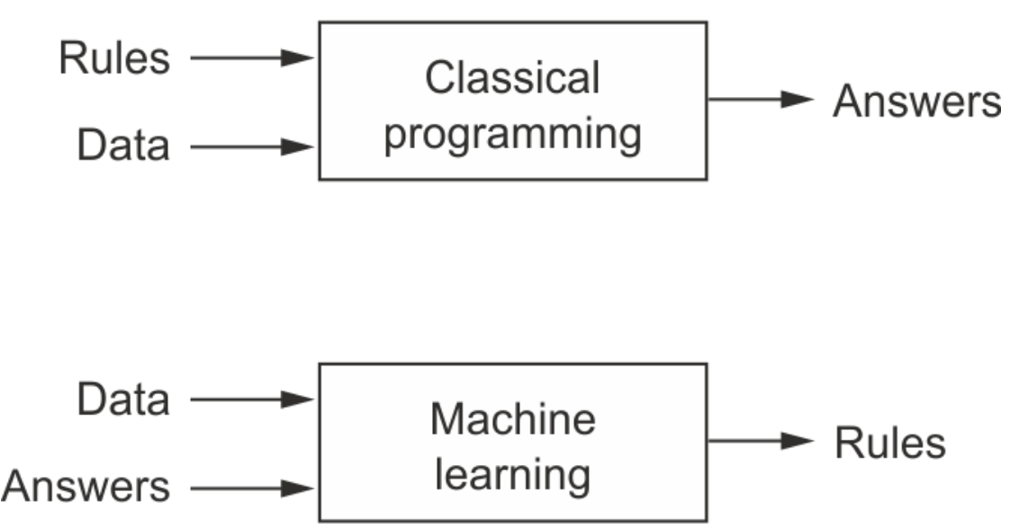
Definitions
What is machine learning?
It is giving the computers the ability to learn to make decisions from data
Without being explicitly programmed!
Image Credit: Francois Chollet (2017). Deep Learning with Python . Manning Publications Co. USA
Notes:
Examples are mentioned in the previous slides.
A machine-learning system is trained rather than explicitly programmed. It’s presented with many examples relevant to a task, and it finds statistical structure in these examples that eventually allows the system to come up with rules for automating the task. (Excerpt from F.chollet’s book)
Use the example of customer segregation - features like what they purchased, time, age

Slide 10
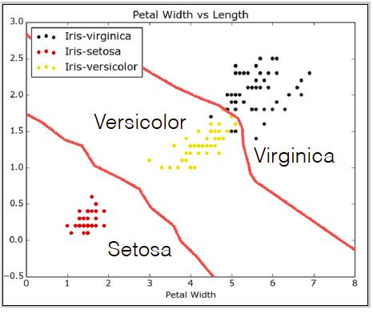
All about decision boundaries

Slide 11
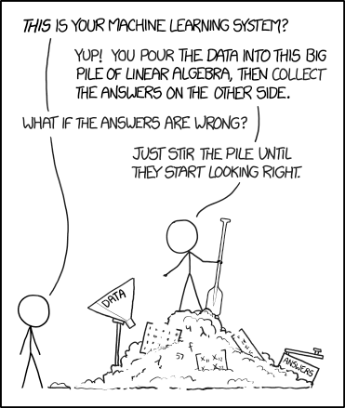
In case your asked in an exam 😄
Image credit: https://xkcd.com/1838/

Slide 12
Definitions
Algorithm - is a recipe someone uses to solve a problem. For instance, the steps you take to prepare a meal. For example, Boyer Moore algorithm (an approximate matching and K-NN algorithm).
How to prepare chapati
Step 1: Buy ingredients to make chapati
Step 2: Call your bro!
Step 3: Ask them to make you chapati

Slide 13
Definitions
Model is a representation for a purpose.
Representation - it stands for something in the real world
Purpose - your particular use of the model
For example a building blueprint real world model
We’ll use a type of mathematical model which is informed by data and puts into account uncertainty and randomness. It will become clearer soon.
Credit: Danny Kaplan http://www.mosaic-web.org/go/StatisticalModeling/
Notes:
They are better than the real thing and cheaper depending on your definition of cheap. It’s easier to add an new wall in a blueprint than an already existing building.

Slide 14
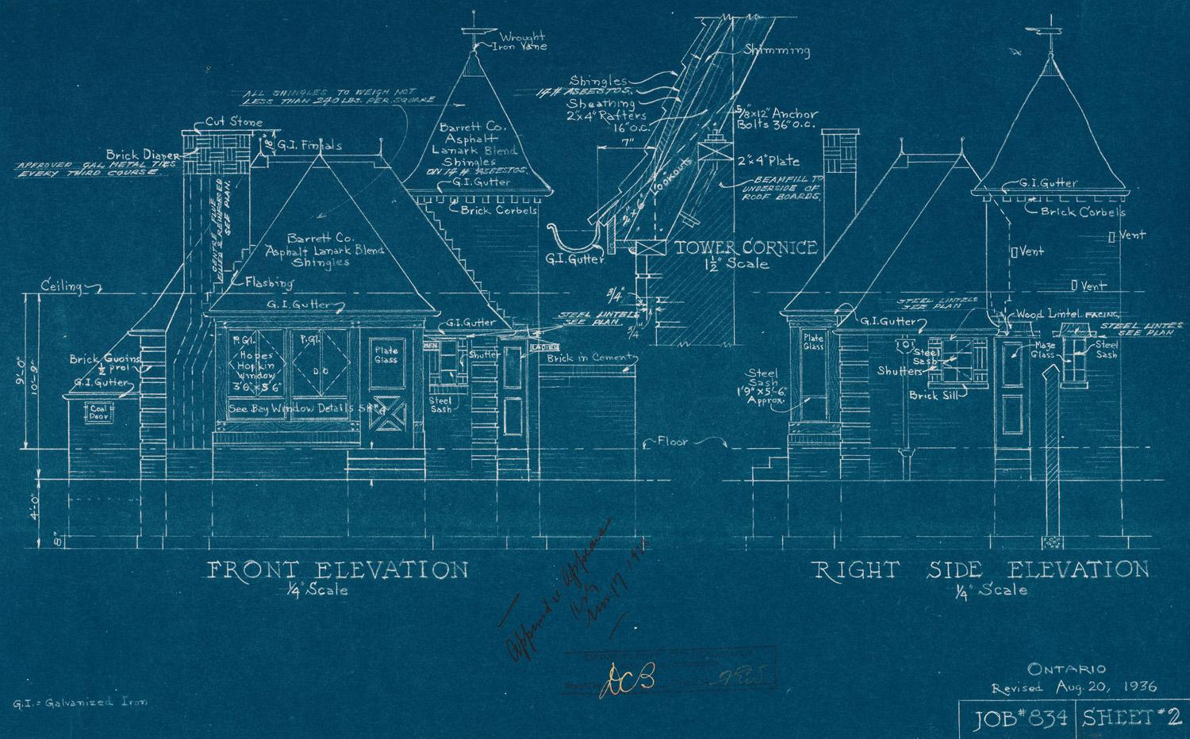
Notes:
Image credit :http://www.remodelormove.com/wp-content/uploads/2010/03/blueprint-example.jpg
T-tests can take you from point A to B: skateboards
Statistical modeling a helicopter go through rugged terrain, get you to your objective faster.

Slide 15
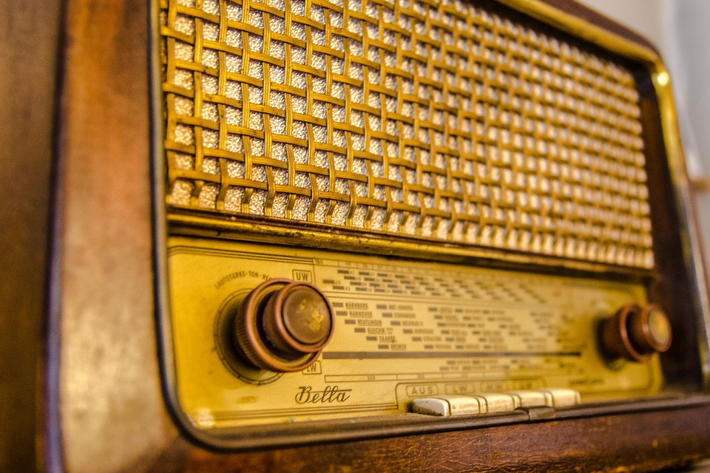
A hyperparameter is? Get it?
Notes:
Gif credit: https://i.imgur.com/VrTB1z8.gif
Old radio credit: google images don’t reem
Tune your radio your metal sounds better same goes for machine learning model in this case, better predictions.
Controls complexity of the model affecting your train and test accuracy

Slide 16
Definitions
What’s a hyperparameter?
Choosing parameters that make us reach an optimal fit. Remember how in linear regression you get a straight line with all the points being close to least squares line?
NB Cannot be gotten by fitting a model. It involves trial and error. You’ll see how in the practical session.
E.g K - Nearest Neighbors n_neighbours argument

Slide 17
The Universal Machine Learning Workflow (1)
Define the problem at hand and the data on which you’ll train. Collect this data, or annotate it with labels if need be.
Classify iris plants into three species(iris-setosa, iris-virginica and iris-versicolor) using their measurements which include:
> sepal length (cm)
> sepal width (cm)
> petal length (cm)
> petal width (cm)
> target/class/species
Notes:
https://www.kaggle.com/uciml/iris where to get the dataset or https://archive.ics.uci.edu/ml/datasets/Iris/

Slide 18
The Universal Machine Learning Workflow (2)
Choose how you’ll measure success on your problem. Which metrics will you monitor on your validation data?
Higher
Accuracy - fraction of flowers for which the right species was predicted.
AUC - summarises performance across all thresholds ranges from 0 to 1.
More at 11.
Notes:
sensitivity / True positive rate used to identify all positive samples and precision/ positive predicted value low false positives

Slide 19
Universal Machine Learning Workflow (3)
Determine your evaluation protocol: hold-out validation? K-fold validation? Which portion of the data should you use for validation?
We’ll use both hold-out validation for this time. Others include: K-fold cross-validation, iterated K-fold validation with shuffling.
Notes:
Explain each in summary. Dwell more on K-fold. Iterated makes highly accurate models. Draw the diagram and explain.

Slide 20
Universal Machine Learning Workflow (4)
Develop a first model that does better than a basic baseline: a model with statistical power.
Model that gets an accuracy higher than 0.5. Usually a model without hyperparameter tuning can help you achieve that.

Slide 21
Universal Machine Learning Workflow (5)
Develop a model that overfits.
Model where training accuracy is higher than test accuracy. Overfitting
Model where training accuracy is lower than test accuracy. Underfitting
Notes:
Model is too complex when overfitting to peculiarities of the train data whereas, when the model is too simple to get the patterns in the data.

Slide 22
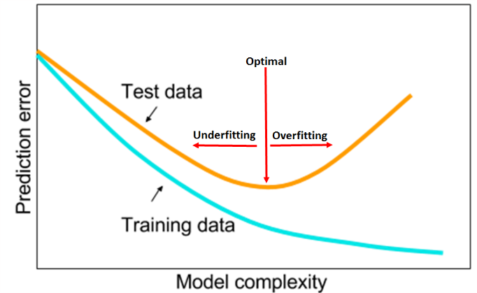
Image credit: Smith 2017

Slide 23
Universal Machine Learning Workflow(5)
Regularize your model and tune its hyperparameters, based on performance on the validation data.
Involves feature engineering (adding or removing a few features that are not informative), tuning hyperparameters and apply L1 and L2 regularization to your scalers.
Notes:
Draw the tree and explain low variance features
Regularization restricts the model to reduce overfitting

Slide 24
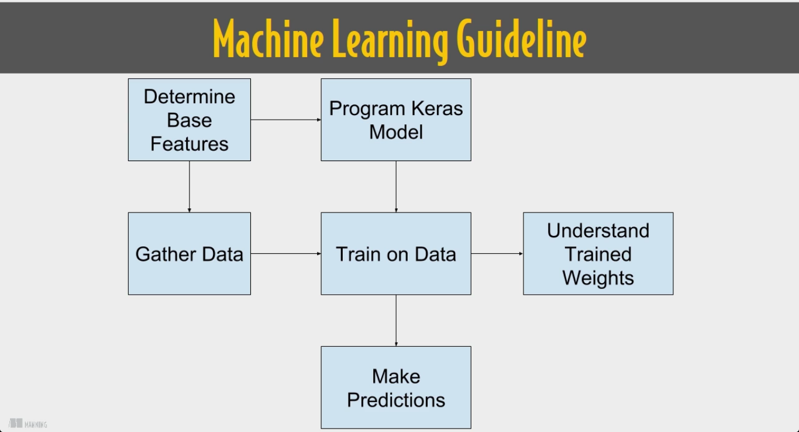
Another version for neural networks
Image credit: Dan Van Boxel Keras in Motion. LiveVideo. Manning publishing

Slide 25
The ML workflow
Define the problem at hand and the data on which you’ll train. Collect this data, or annotate it with labels if need be.
Choose how you’ll measure success on your problem. Which metrics will you monitor on your validation data?
Determine your evaluation protocol: hold-out validation? K-fold validation? Which portion of the data should you use for validation?
Develop a first model that does better than a basic baseline: a model with statistical power.
Develop a model that overfits.
Regularize your model and tune its hyperparameters, based on performance on the validation data.

Slide 26
Time for the practical

Slide 27
Review of what we’ve done
You’ve learned what machine learning entails, what an algorithm is, a model and a hyperparameter
You’ve learned machine learning workflows to get you started with competitions.
Went through the practical session
You’ve gone through an example of supervised learning in R and Python
Try what you’ve learned on the ‘Don’t overfit competition on Kaggle.’

Slide 28
Conclusion
The workflows presented are just a guideline. They are not set in stone.
Remember the Occam’s razor principle: given two explanations for something, the explanation most likely to be correct is the simplest one—the one that makes fewer assumptions. The simpler the model the less likely it is to overfit.
Sometimes machine learning is not the answer.

Slide 29
Who am I ?
Ben Mainye
Data scientist, researcher (focus: data science/genomic data science, AI and stuff i find interesting)
DIY biologist
Skateboarder
Follow me on twitter @Shuyin_ben and github Shuyib

Slide 30
Feedback
How was presentation? Tell me here
Use #NairobiWiMLDS when posting on social media. Others you can tag @_tabbz and @siminyu_kat on twitter.

